Slide 1
Introductory Review
SAS
Measures of centrality
Confidence intervals
Hypothesis testing

Slide 2
Statistical flow chart
Question
Experiment
Visualize
Import
Clean
Communicate
Transform
Model
Most statistics classes emphasize “Model” and “Communicate”
It is important to keep in mind the entire process
Actually, the flow chart is really a loop

Slide 3
SAS

Slide 4
Getting Started with SAS
SAS is a powerful tool for analyzing data
To get the most out of this class, you should become conversant in SAS
You can access SAS in at least three ways:
A local copy installed on your computer
A remote copy hosted by the “Citrix” SMU server
A remote copy hosted by SAS (SAS onDemand)

Slide 5
Remote Copy
https://odamid.oda.sas.com/SASODARegistration/
A confirmation email will be sent to the email address
After registering, you can join this class:
https://odamid.oda.sas.com/SASODAControlCenter/enroll.html?enroll=79763c48-3d66-4faa-b802-14db272bc718

Slide 6

Learning SAS
After registering for SAS onDemand, you get access to some SAS tutorials:

Slide 7
Learning SAS
Also, here are some links to brief introductory videos:
http://video.sas.com/detail/videos/programming/video/4573016765001/writing-a-basic-sas-program?autoStart=true
http://video.sas.com/detail/videos/managing-data/video/4573016761001/filtering-a-sas-table-in-a-data-step?autoStart=true
http://video.sas.com/detail/videos/managing-data/video/4573016759001/performing-conditional-logic-in-sas?autoStart=true
What does a typical SAS session look like?

Slide 8
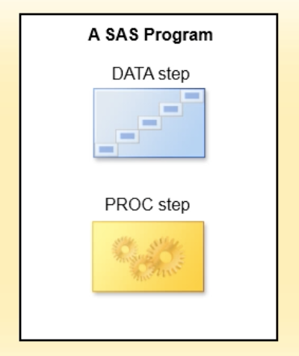
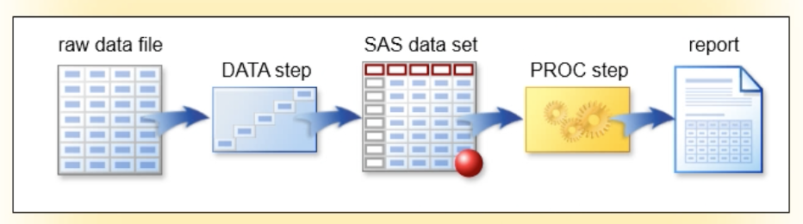
SAS overview
Every SAS session is some combination of DATA and PROC steps
An example SAS session might look like:

Slide 9
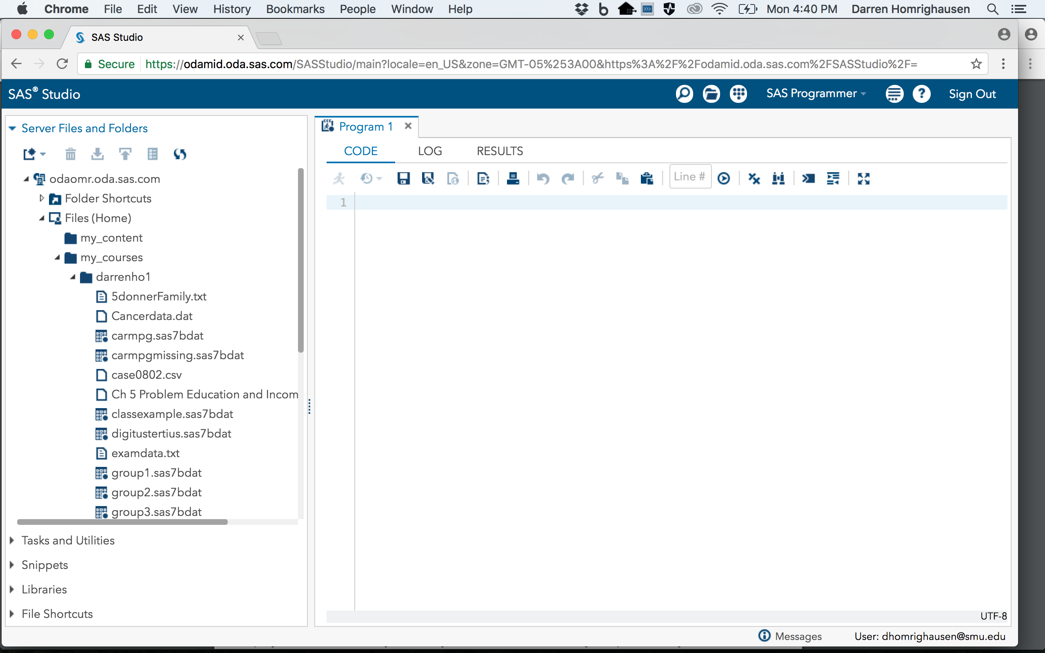
SAS session
Log Tab
Results Tab
Code/Editor Tab
Files/Data

Slide 10
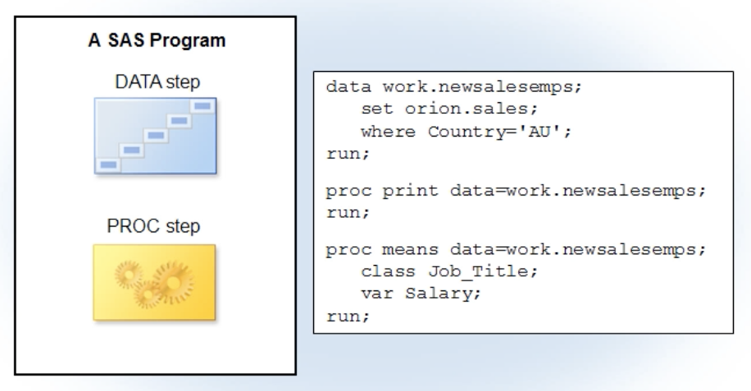
SAS session: Editor

Slide 11
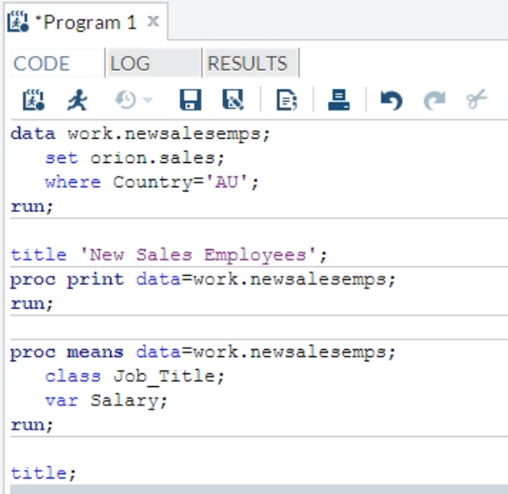
SAS session: Editor/Code

Slide 12
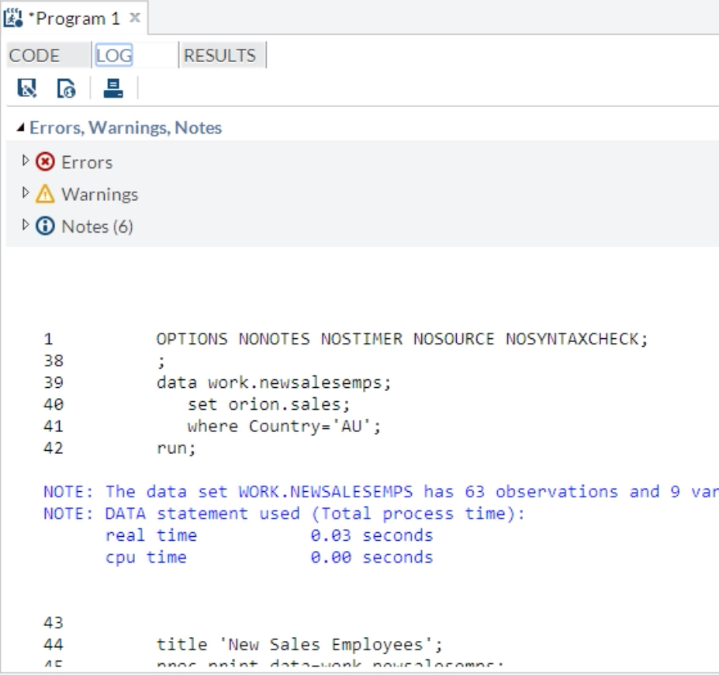
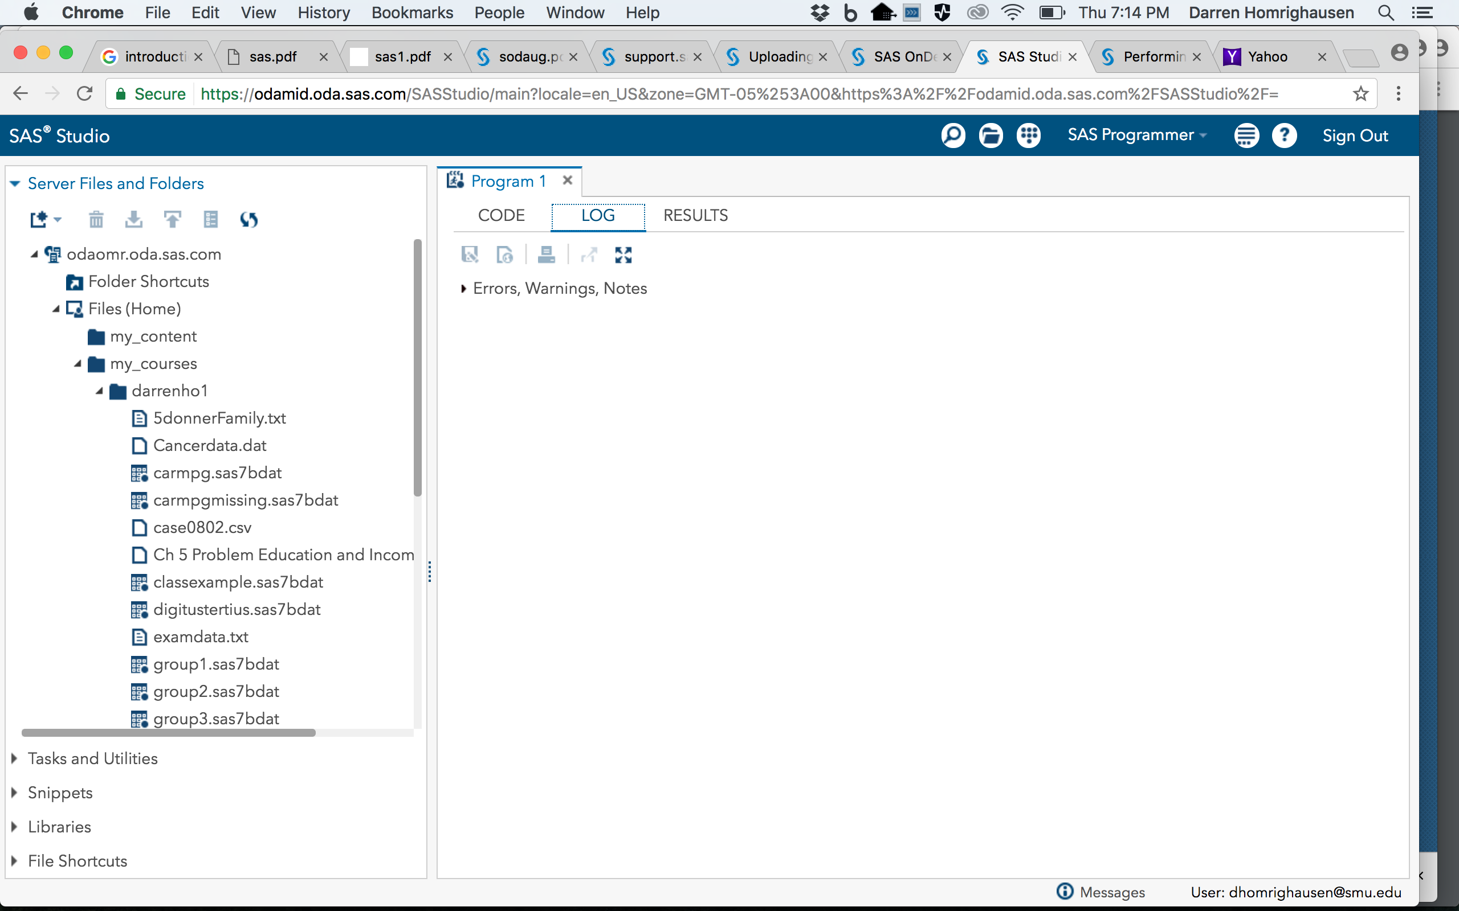
SAS session: Log

Slide 13
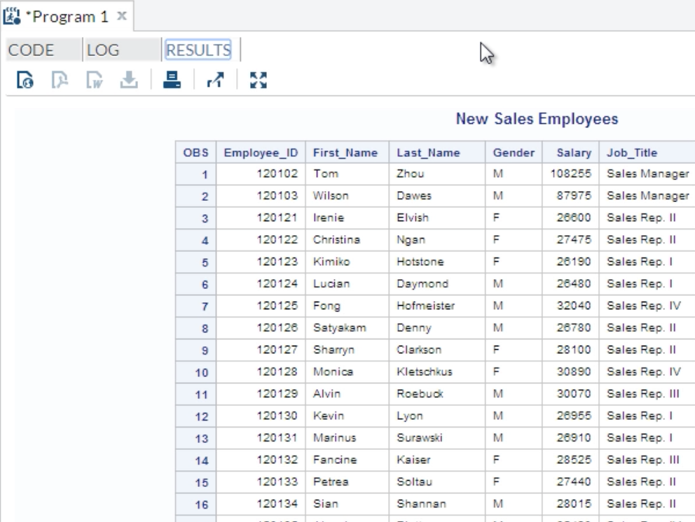
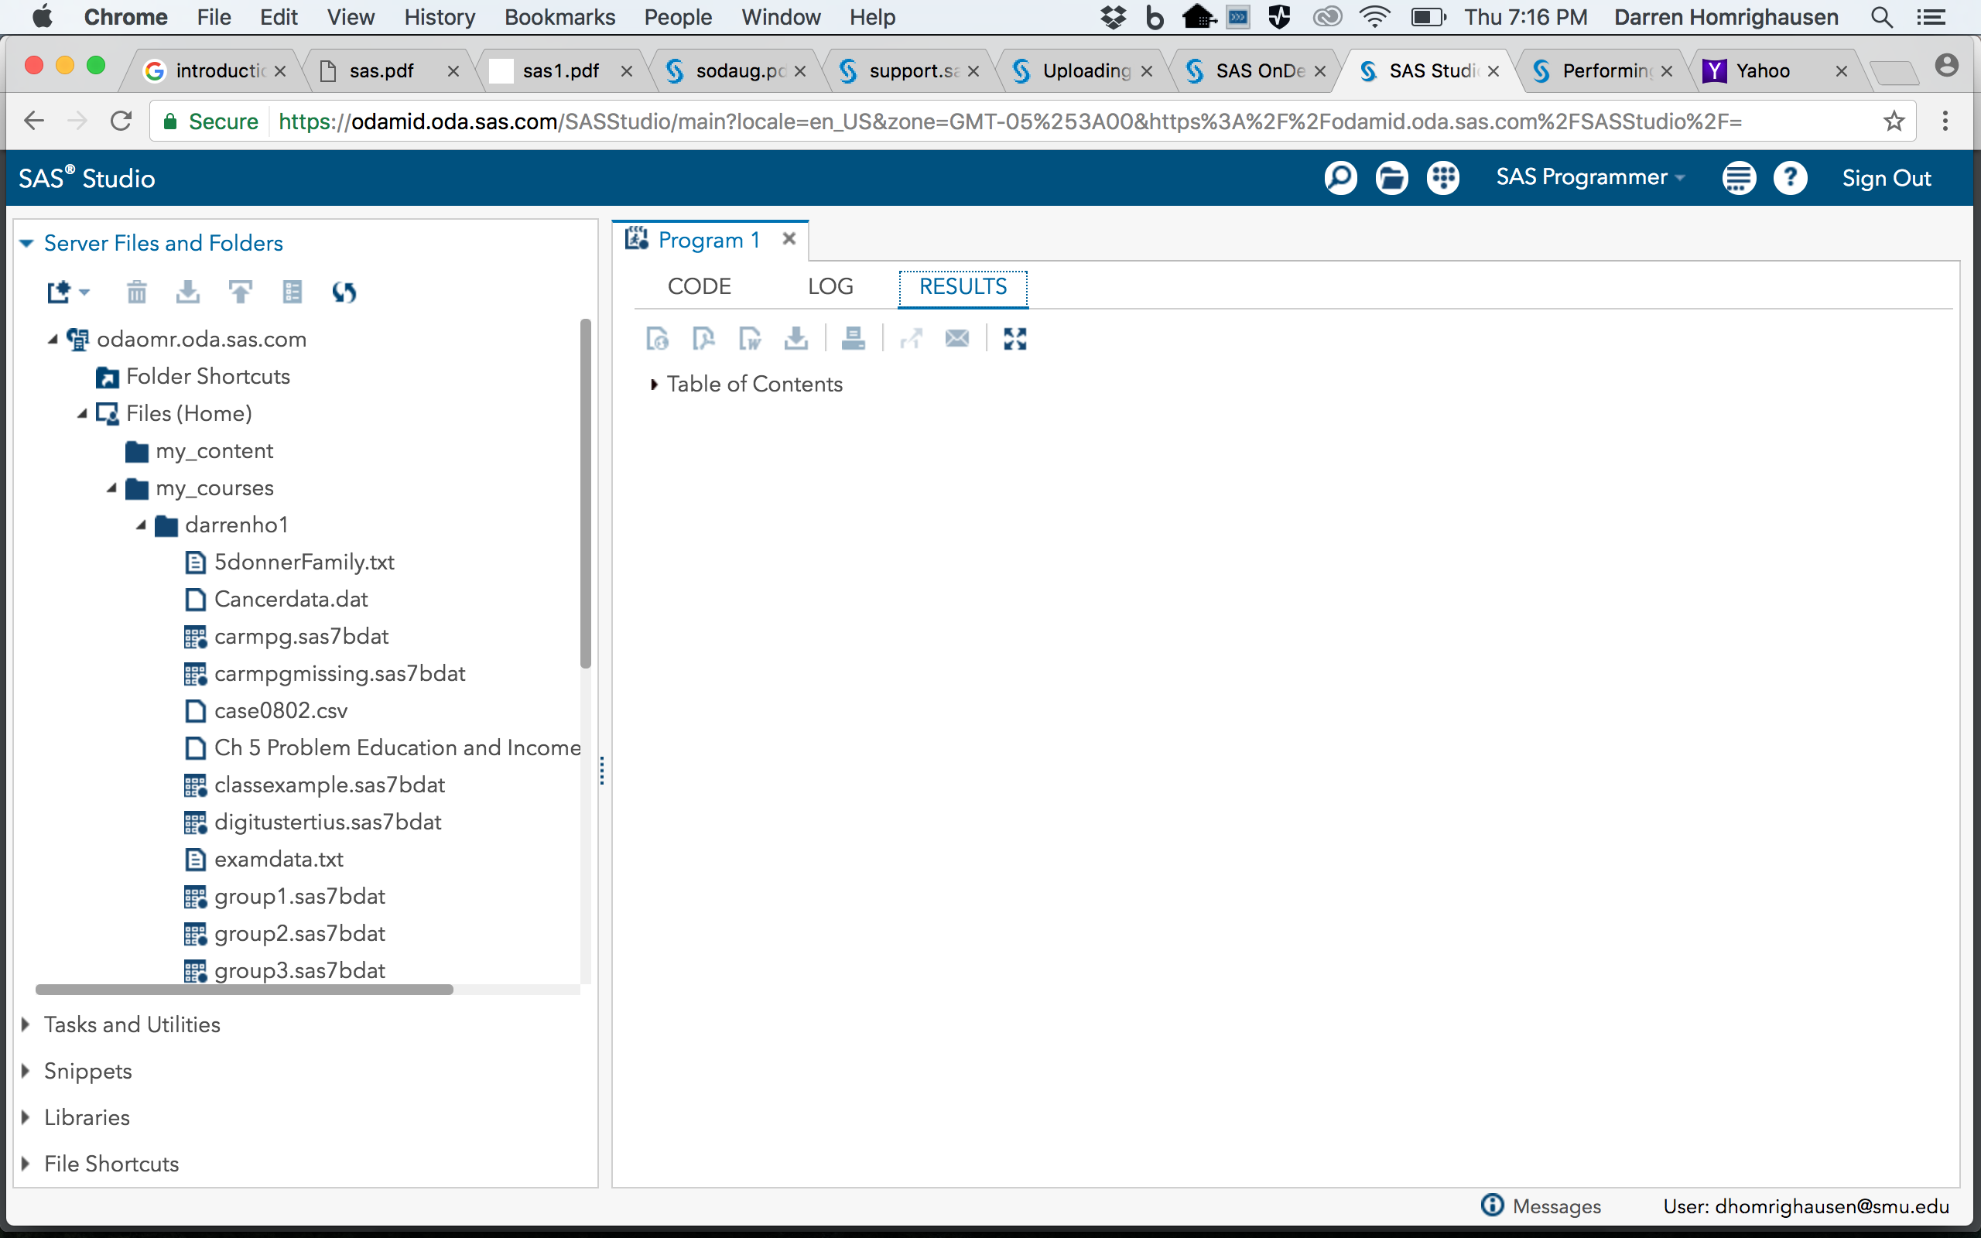
SAS session: Results

Slide 14
Measures of centrality

Slide 15
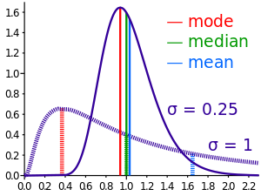
Mean, Median, and Mode
Notes:
Section 1.5.2 in book covers the book’s terminology for population mean/sd vs sample average/sd

Slide 16
Estimating the population mean

Slide 17
Assumptions
We will return to these later…

Slide 18
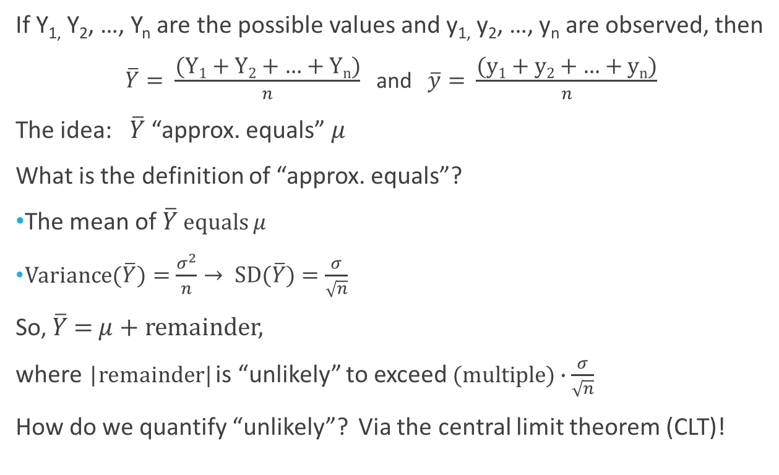
The sample mean
If Y_{1,} Y₂, …, Y_{n} are the possible values and y_{1,} y₂, …, y_{n} are observed, then
$\overline{Y}= \frac{\text{(}\text{Y}\text{1}\text{ + }\text{Y}\text{2}\text{ + … + }\text{Y}\text{n}\text{)}}{n}$ and $\overline{y}= \frac{\text{(}\text{y}\text{1}\text{ + }\text{y}\text{2}\text{ + … + }\text{y}\text{n}\text{)}}{n}$
The idea: $\overline{Y}$ “approx. equals” $μ$
What is the definition of “approx. equals”?
The mean of $\overline{Y}$ equals $μ$
Variance($\overline{Y})=\frac{σ^{2}}{n}→ \text{SD}\text{(}\overline{Y})=\frac{σ}{\sqrt{n}}$
So, $\overline{Y} \text{=} μ$ + remainder,
where |remainder| is “unlikely” to exceed $(multiple)∙\frac{σ}{\sqrt{n}}$
How do we quantify “unlikely”? Via the central limit theorem (CLT)!
(note: this goes to 0 as n increases and is the law of large numbers)

Slide 19
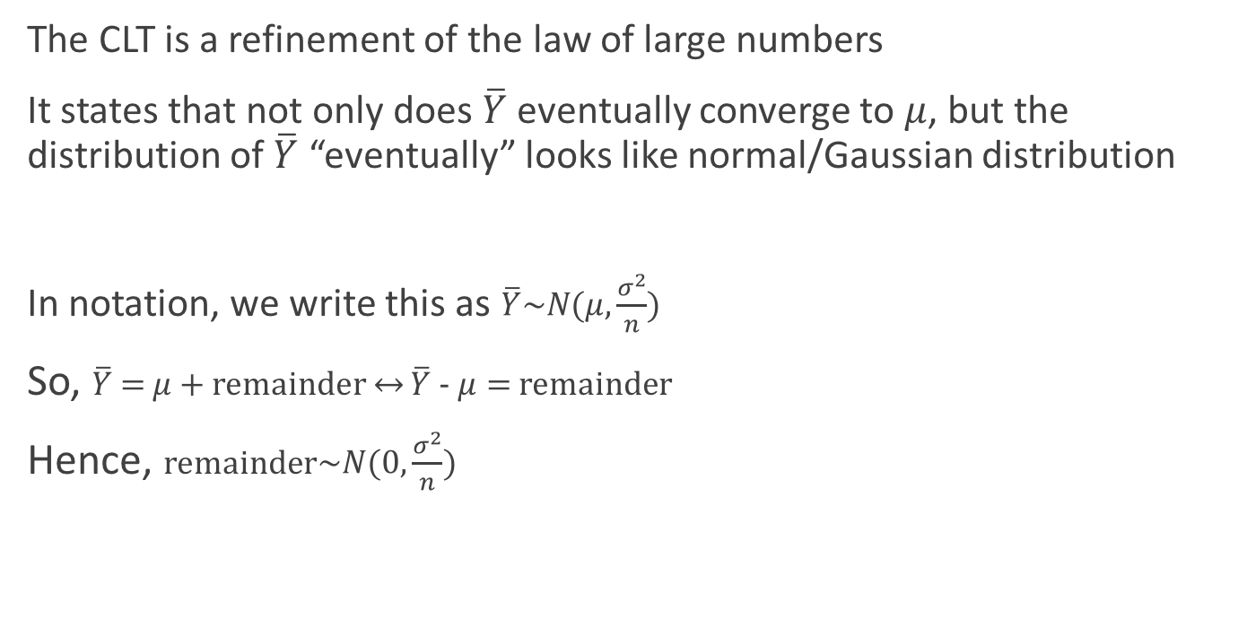
The central limit theorem CLT)
The CLT is a refinement of the law of large numbers
It states that not only does $\overline{Y}$ eventually converge to $μ$, but the distribution of $\overline{Y}$ “eventually” looks like normal/Gaussian distribution
In notation, we write this as $\overline{Y}\sim N(μ,\frac{σ^{2}}{n})$
So, $\overline{Y} \text{=} μ$+ remainder $↔$ $\overline{Y} \text{− }μ=$ remainder
Hence, remainder$\sim N(0,\frac{σ^{2}}{n})$
(“eventually”: commonly taken to be n>30 and obs. are independent)
Notes:
In class: go over quantiles of normal distribution. What is the formal definition of z_{alpha/2} Questions to ask: what does z_{1-alpha/2} equal? What does z_{1/2} equal?

Slide 20
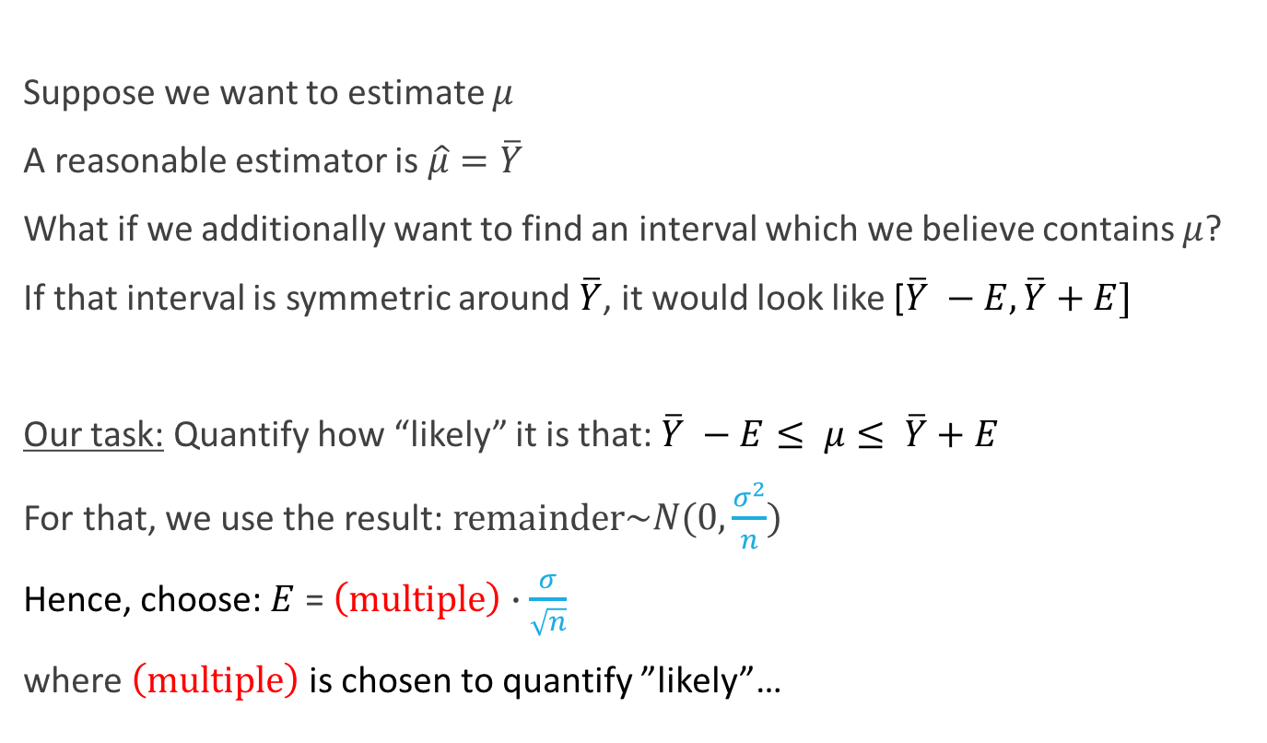
Confidence interval for the population mean
Suppose we want to estimate $μ$
A reasonable estimator is $\hat{μ}=\overline{Y}$
What if we additionally want to find an interval which we believe contains $μ$?
If that interval is symmetric around $\overline{Y}$, it would look like [$\overline{Y} −E, \overline{Y}+E]$
Our task: Quantify how “likely” it is that: $\overline{Y} −E≤ μ≤ \overline{Y}+E$
For that, we use the result: remainder$\sim N(0,\frac{σ^{2}}{n})$
Hence, choose: $E$ = $\left(multiple\right)∙\frac{σ}{\sqrt{n}}$
where $\left(multiple\right)$ is chosen to quantify ”likely”…

Slide 21
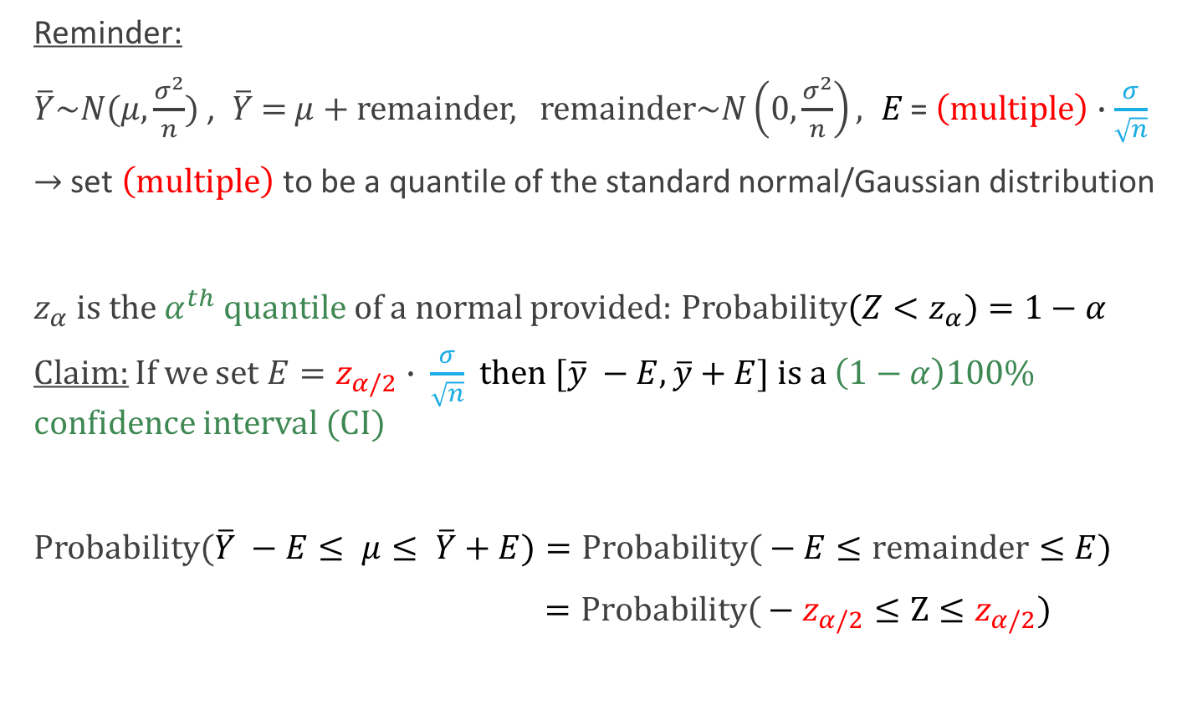
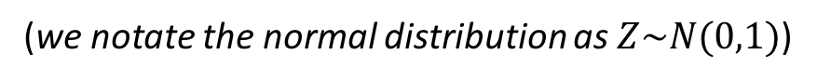
Confidence interval for the population mean
Reminder:
$\overline{Y}\sim N(μ,\frac{σ^{2}}{n})$ , $\overline{Y} \text{=} μ$+ remainder, remainder$\sim N\left(0,\frac{σ^{2}}{n}\right), E\text{ = }\left(multiple\right)∙\frac{σ}{\sqrt{n}}$
$→$ set $\left(multiple\right)$ to be a quantile of the standard normal/Gaussian distribution
$z_{α}$ is the$α^{th}$ quantile of a normal provided: Probability${(Z<z}_{α})=1−α$
Claim: If we set $E=z_{α/2}$ $∙$ $\frac{σ}{\sqrt{n}}$ then $[\overline{y} −E, \overline{y}+E]$ is a $\left(1−α\right)100\%$ confidence interval (CI)
Probability($\overline{Y} −E≤ μ≤ \overline{Y}+E)=\text{Probability}\text{(}−E≤\text{remainder}≤E)$
$=\text{Probability}\text{(}−z_{α/2}≤\text{Z}≤z_{α/2})$
(we notate the normal distribution as $Z\sim N(0,1)$)
(Proof sketch)
Notes:
In class: go over quantiles of normal distribution. What is the formal definition of z_{alpha/2} Questions to ask: what does z_{1-alpha/2} equal? What does z_{1/2} equal?

Slide 22

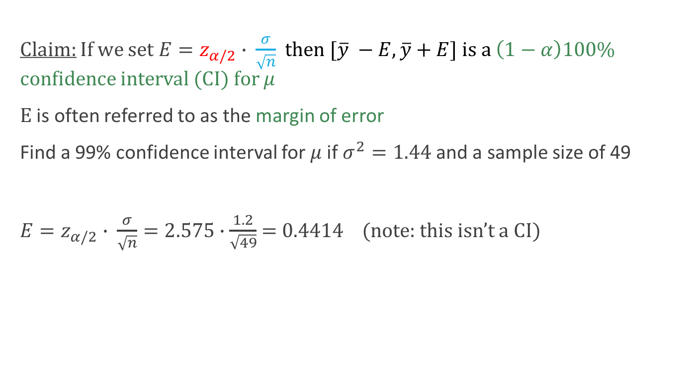
Example:
Claim: If we set $E=z_{α/2}$ $∙$ $\frac{σ}{\sqrt{n}}$ then $[\overline{y} −E, \overline{y}+E]$ is a $\left(1−α\right)100\%$ confidence interval (CI) for $μ$
$E$ is often referred to as the margin of error
Find a 99% confidence interval for $μ$if $σ^{2}=1.44$ and a sample size of 49
$E=z_{α/2}$ $∙$ $\frac{σ}{\sqrt{n}}=2.575∙\frac{1.2}{\sqrt{49}}$ = 0.4414 (note: this isn’t a CI)
Notes:
In class: go over quantiles of normal distribution. What is the formal definition of z_{alpha/2} Questions to ask: what does z_{1-alpha/2} equal? What does z_{1/2} equal?

Slide 23
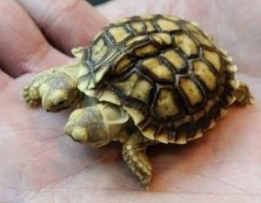
Hypothesis testing
- THE POLYCEPHALIC TWIN OF CONFIDENCE INTERVALS

Slide 24
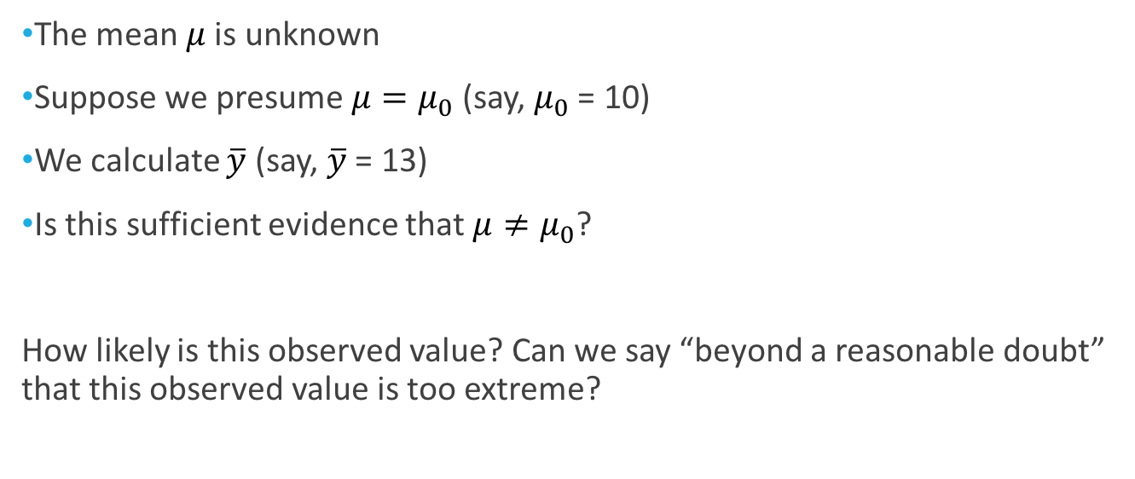
Let’s look at the mean
The mean $μ$ is unknown
Suppose we presume $μ=μ_{0}$ (say, $μ_{0}$ = 10)
We calculate $\overline{y}$ (say, $\overline{y}$ = 13)
Is this sufficient evidence that $μ≠μ_{0}$?
How likely is this observed value? Can we say “beyond a reasonable doubt” that this observed value is too extreme?

Slide 25
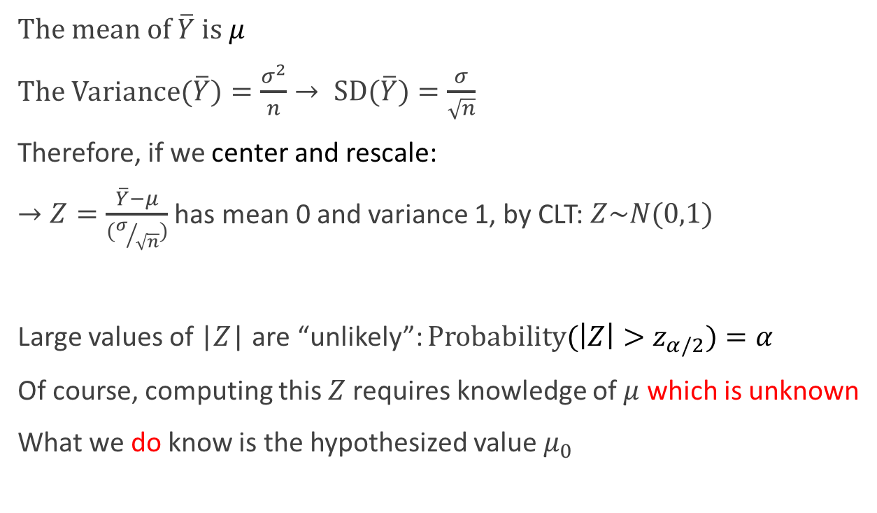
How much variation should we expect?
The mean of $\overline{Y}$ is $μ$
The Variance($\overline{Y})=\frac{σ^{2}}{n}→ \text{SD}\text{(}\overline{Y})=\frac{σ}{\sqrt{n}}$
Therefore, if we center and rescale:
$→Z=\frac{\overline{Y}−μ}{(σ/{\sqrt{n}})}$ has mean 0 and variance 1, by CLT: $Z\sim N(0,1)$
Large values of |$Z$| are “unlikely”: Probability${(\left|Z\right|>z}_{α/2})=α$
Of course, computing this $Z$ requires knowledge of $μ$ which is unknown
What we do know is the hypothesized value $μ_{0}$
(assuming $n$ is large enough and obs. are independent)

Slide 26
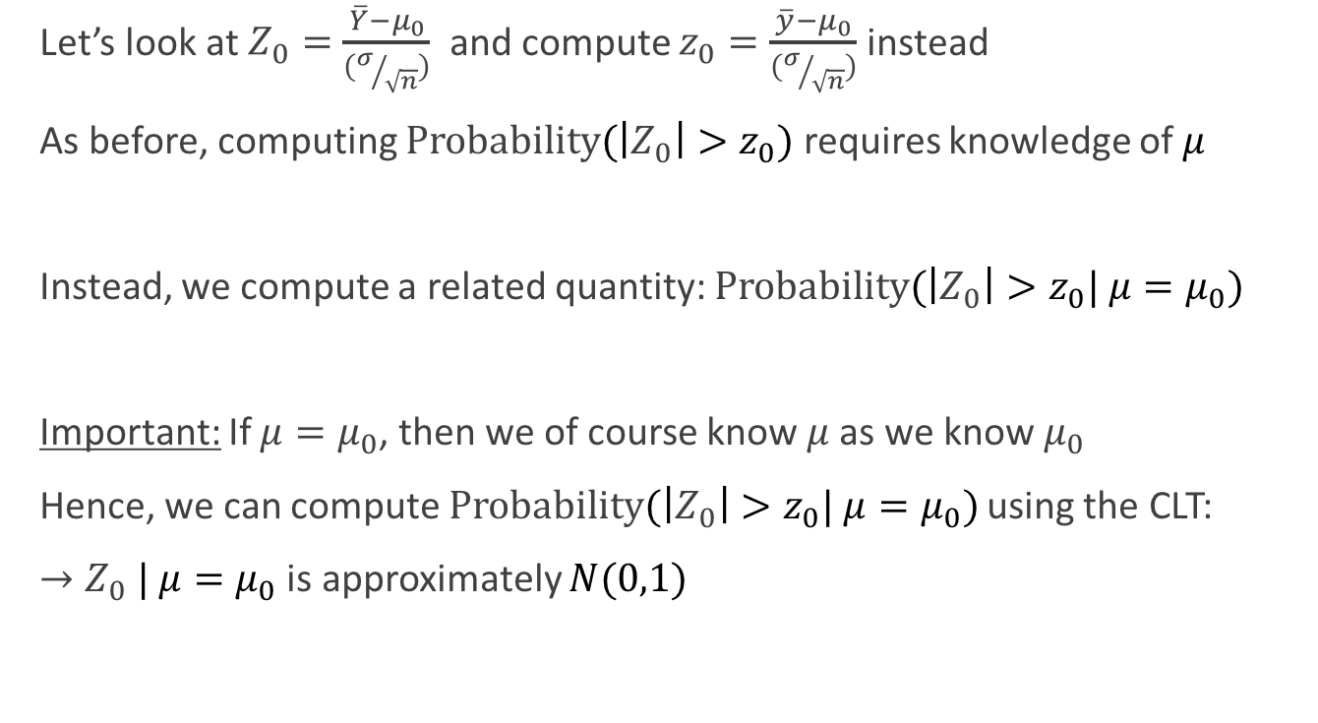
How much variation should we expect?
Let’s look at $Z_{0}=\frac{\overline{Y}−μ_{0}}{(σ/{\sqrt{n}})}$ and compute $z_{0}=\frac{\overline{y}−μ_{0}}{(σ/{\sqrt{n}})}$ instead
As before, computing Probability${(\left|Z_{0}\right|>z}_{0})$requires knowledge of $μ$
Instead, we compute a related quantity: Probability${(\left|Z_{0}\right|>z}_{0}| μ=μ_{0})$
Important: If $μ=μ_{0}$, then we of course know $μ$ as we know $μ_{0}$
Hence, we can compute Probability${(\left|Z_{0}\right|>z}_{0}| μ=μ_{0})$ using the CLT:
$→Z_{0} | μ=μ_{0}$ is approximately $N(0,1)$
(after all, we showed that the distribution of $\overline{Y}$ depends on $μ$)
(this is a conditional probability under the hypothesis that $μ=μ_{0}$)

Slide 27
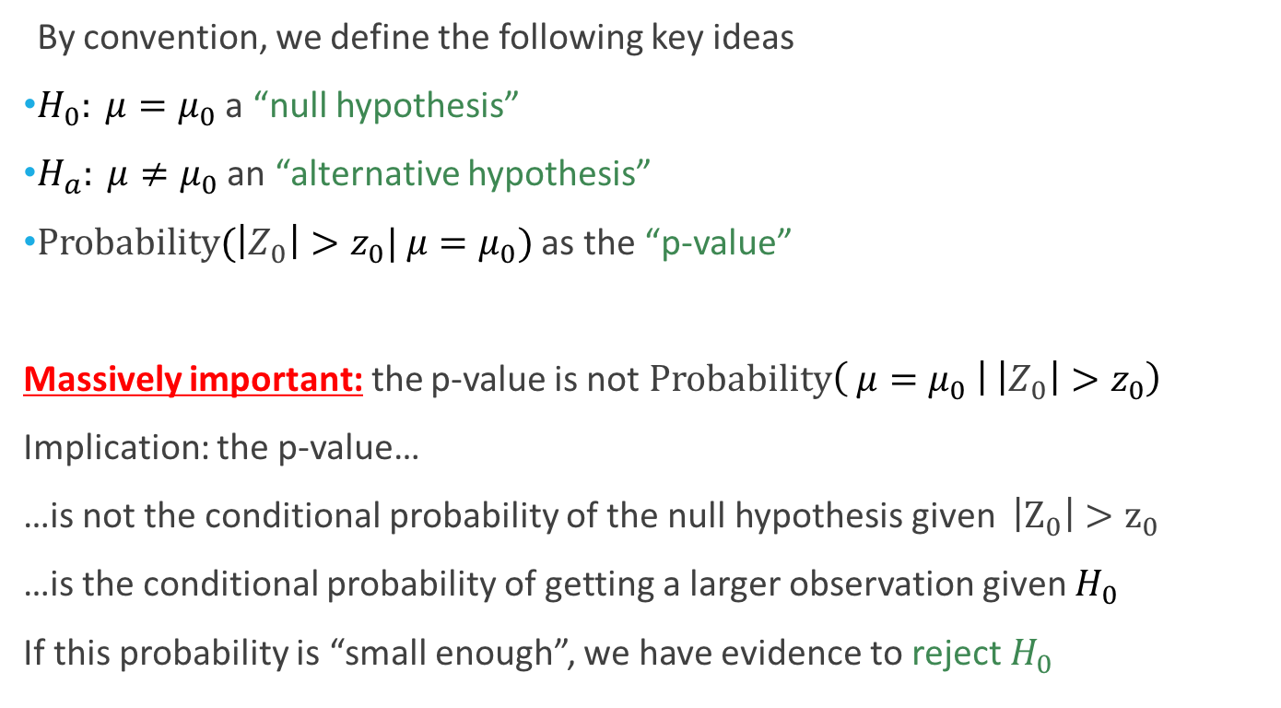
Hypothesis Testing: Definitions
By convention, we define the following key ideas
$H_{0}: μ=μ_{0}$ a “null hypothesis”
$H_{a}: μ≠μ_{0}$ an “alternative hypothesis”
Probability${(\left|Z_{0}\right|>z}_{0}| μ=μ_{0})$ as the “p-value”
Massively important: the p-value is not Probability$\left( μ=μ_{0} | { \left|Z_{0}\right|>z}_{0}\right)$
Implication: the p-value…
…is not the conditional probability of the null hypothesis given ${ \left|Z_{0}\right|>z}_{0}$
…is the conditional probability of getting a larger observation given $H_{0}$
If this probability is “small enough”, we have evidence to reject $H_{0}$
(sometimes alternatively written: Probability${(\left|Z_{0}\right|>z}_{0}|H_{0})$)

Slide 28
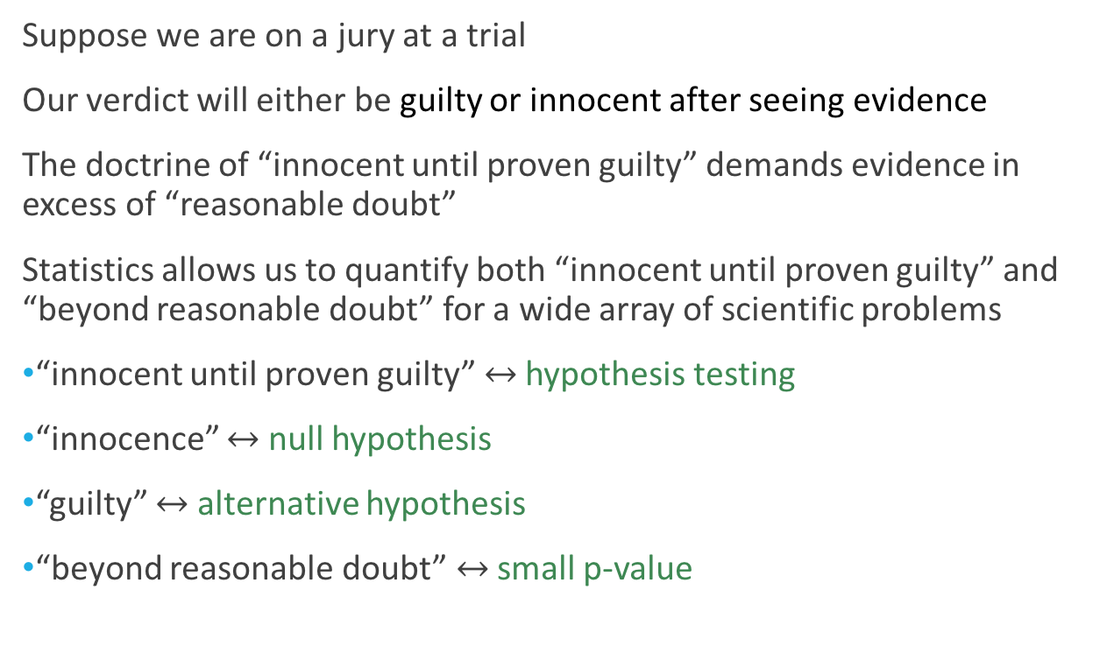
Hypothesis testing: An analogy
Suppose we are on a jury at a trial
Our verdict will either be guilty or innocent after seeing evidence
The doctrine of “innocent until proven guilty” demands evidence in excess of “reasonable doubt”
Statistics allows us to quantify both “innocent until proven guilty” and “beyond reasonable doubt” for a wide array of scientific problems
“innocent until proven guilty” $↔$ hypothesis testing
“innocence” $↔$ null hypothesis
“guilty” $↔$ alternative hypothesis
“beyond reasonable doubt” $↔$ small p-value

Slide 29
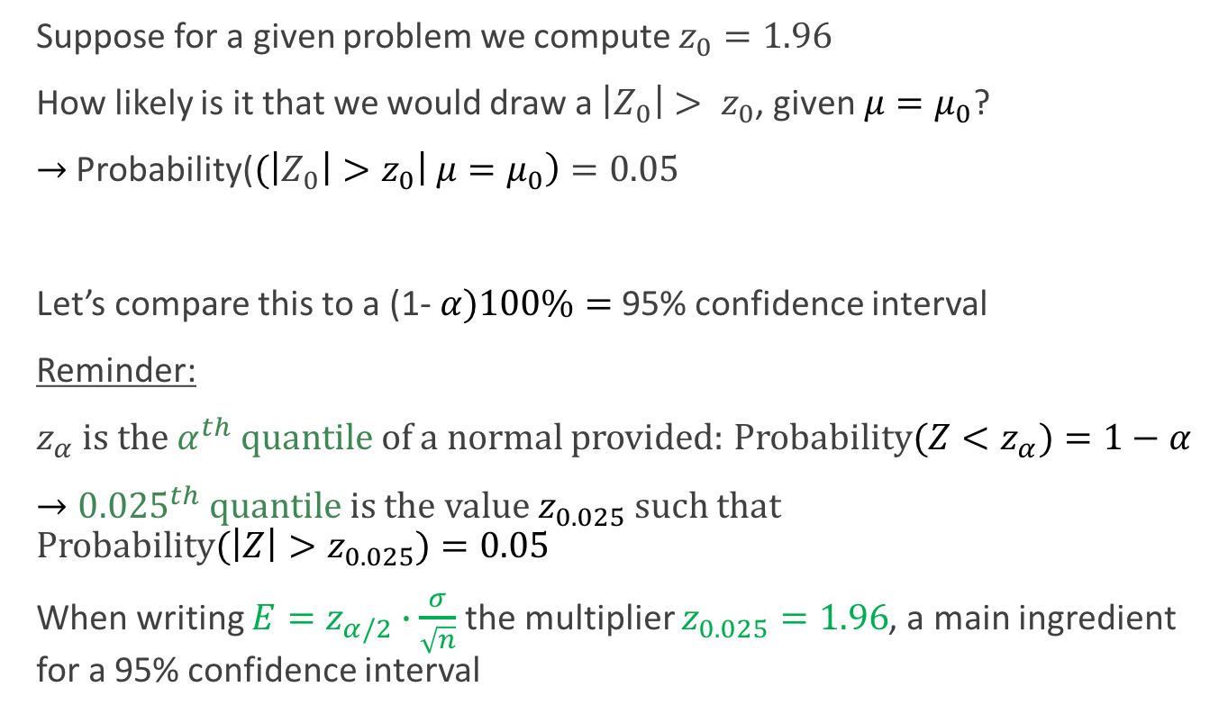
Confidence intervals and hypothesis tests
Suppose for a given problem we compute $z_{0}=1.96$
How likely is it that we would draw a $\left|Z_{0}\right|> z_{0}$, given$μ=μ_{0}$?
$→$Probability(${(\left|Z_{0}\right|>z}_{0}\left| μ=μ_{0}\right)=0.05$
Let’s compare this to a (1- $α)100\%=$95% confidence interval
Reminder:
$z_{α}$ is the$α^{th}$ quantile of a normal provided: Probability${(Z<z}_{α})=1−α$
$→0{.025}^{th}$ quantile is the value $z_{0.025}$ such that Probability${(\left|Z\right|>z}_{0.025})=0.05$
When writing ${E=z}_{α/2}∙\frac{σ}{\sqrt{n}}$ the multiplier $z_{0.025}=1.96$, a main ingredient for a 95% confidence interval
Notes:
Here, we want to draw the standard normal curve

Slide 30
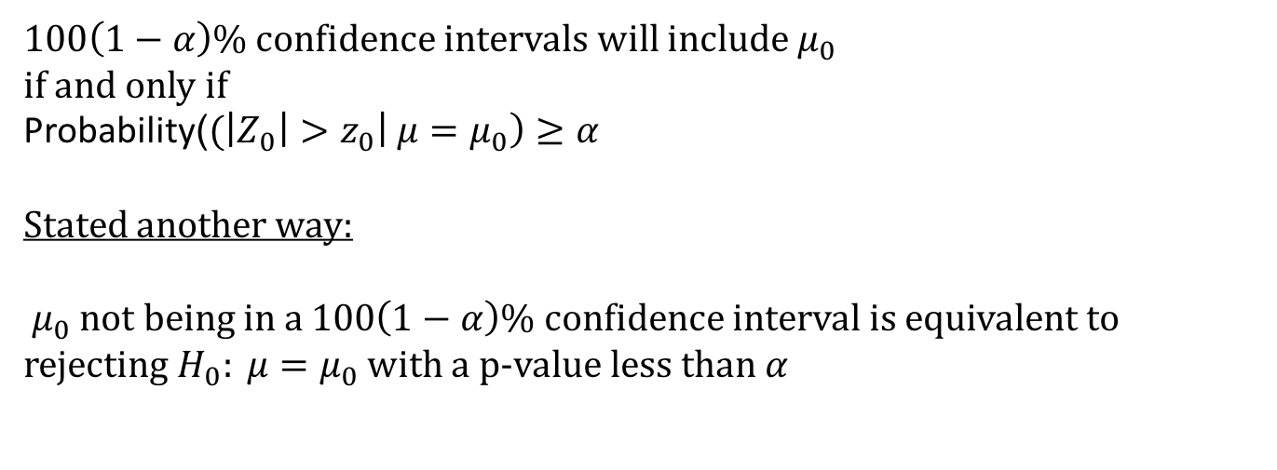
The connection
$100\left(1−α\right)$% confidence intervals will include $μ_{0}$
if and only if
Probability(${(\left|Z_{0}\right|>z}_{0}\left| μ=μ_{0}\right)≥α$
Stated another way:
$μ_{0}$ not being in a $100\left(1−α\right)$% confidence interval is equivalent to rejecting $H_{0}: μ=μ_{0}$ with a p-value less than $α$
(There are some caveats here. If Z takes on too few of values or if we are doing “one sided hypothesis tests”, some adjustments are necessary)
Notes:
Here, we want to draw the standard normal curve

